Slide 1
APPARTMENT MANAGEMENT SYSTEM

Slide 2
ABSTRACT
Apartment Management system is PHP project which provides a way for Owners to register tenants in modern way rather than registering in registers. This project Apartment Management system is solution for Apartment Owners to manage the tenants in an easier and more convenient way. The administrator/Developer, is able to view all the owners of there building's apartment as well as their details. The basic structure of the system is as follows. This project manages the tenants and keeps the rent payment records. This system also maintains the tenants details.
The main purpose of this project is to automate apartment management to manage the owners and tenants. It provides the way for tenants to make payment of Rent easily. and stores the transaction records in a secure data base.

Slide 3
HARDWARE SPECFICATION
Processor : P 4 700 GHz.
RAM : 4 GB RAM
Hard Disk Drive : 180 GB

Slide 4
SOFTWARE SPECIFICATION
Operating System : Windows 7/8/10
Front End : PHP
Back End : SQL

Slide 5
EXISTING SYSTEM
The existing records were manually managed by the resources of the construction company. It was a huge task as they had to maintain a large database of customers who have bought the flats along with their dates, amount paid etc. They also had to manage the data related to the maintenance activities of all the flat owners
DISADVANTAGES
It required lot of time and resources
. There was no way to find easily when the customer had to pay the installment for maintenance, etc details.
The user had to manually search for all the records pertaining to each apartment and then prepare a report of all the outstanding payments.

Slide 6
PROPOSED SYSTEM
This is a simple user interface developed using php technology. The interface helps the user to login through the system and add the details regarding the apartment. The interface takes as input the name of the customer, Phone number, address, the apartment number, Area of the house, Amount per square foot etc. These details are stored in the database. If the apartment is sold to the customer, then these details are stored in the sales tables. It will have a unique sale deed number generated for each of the flats. The interface also has maintenance panel. This panel holds information such as name of the owner, the date of purchase, the maintenance charges to be paid, quarterly or annually, Mode of payment etc. These details are stored in the maintenance tables in the database. The user can query on the database and fetch this information very easily.
ADVANTAGES
This interface helps the user to make all these payments regarding maintenance and purchase of flats etc.
Online payment rent option also available

Slide 7
Modules
New Building Registration
The admin mainly focusses to create a new building details, apartment has an several blocks are there so which need required to create block.
New Room Registration
This module admin generates the room number, we can search the details by this room number we can defined the room rent also here.
New Tenant Registration
Here the new Tenant details has been capturing here, based on this detail to we can generate the report to someone. We can collect all the information in this screen.

Slide 8
Admin & Tenant Login
Here there’s a two-way user is there; one is an admin and Tenant. Admin works to manage the software, tenant work as an managing the rent payment.
Rent Payment
When Tenant need to pay room rent, just login into this application and will do the payment.

Slide 9

Data Flow Diagram
Level 0

Slide 10
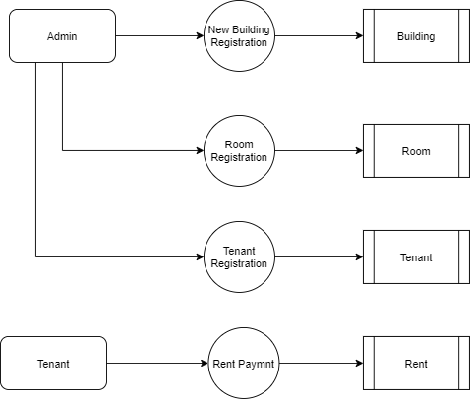
Level 1:

Slide 11
Thank You

